Slide 1
Elementary Matrices
(from §2.2)
Advanced Topics

Slide 2
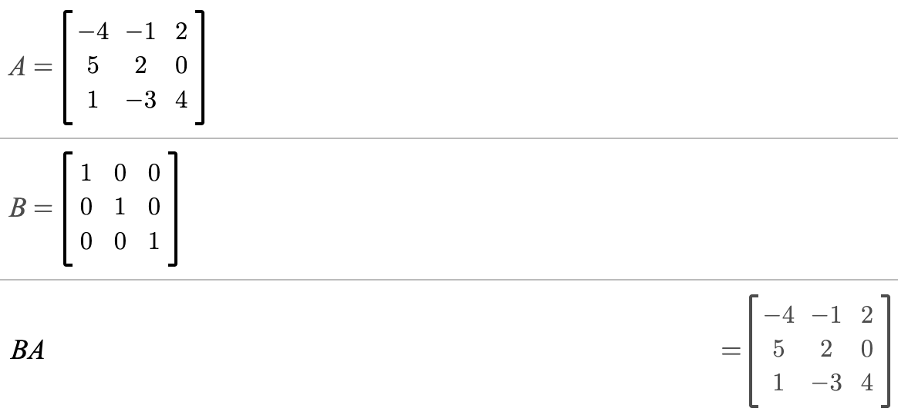

Slide 3


Slide 4
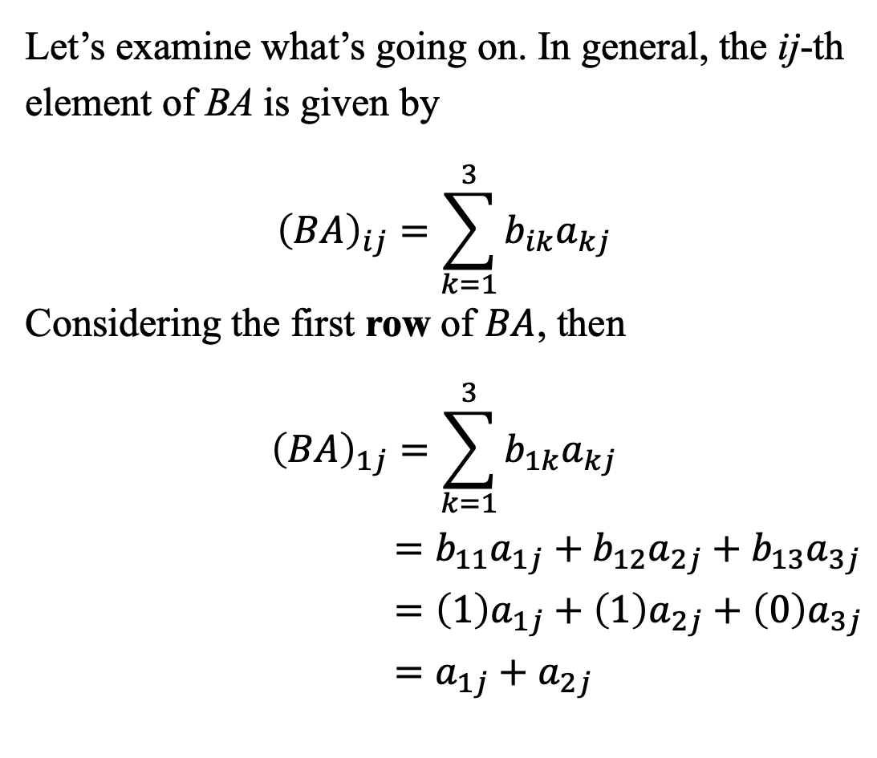
Let’s examine what’s going on. In general, the ij-th element of BA is given by
$${\left(BA\right)}_{ij}=\sum_{k=1}^{3}{b_{ik}a_{kj}}$$
Considering the first row of $BA$, then
$${\left(BA\right)}_{1j}=\sum_{k=1}^{3}{b_{1k}a_{kj}}$$
$$=b_{11}a_{1j}+b_{12}a_{2j}+b_{13}a_{3j}$$
$$=\left(1\right)a_{1j}+\left(1\right)a_{2j}+\left(0\right)a_{3j}$$
$$=a_{1j}+a_{2j}$$

Slide 5
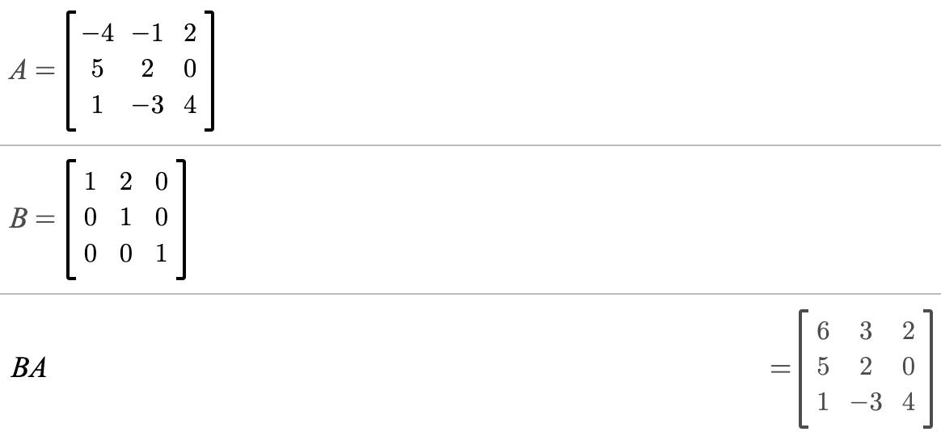

Considering the first row of $BA$, then

Slide 6
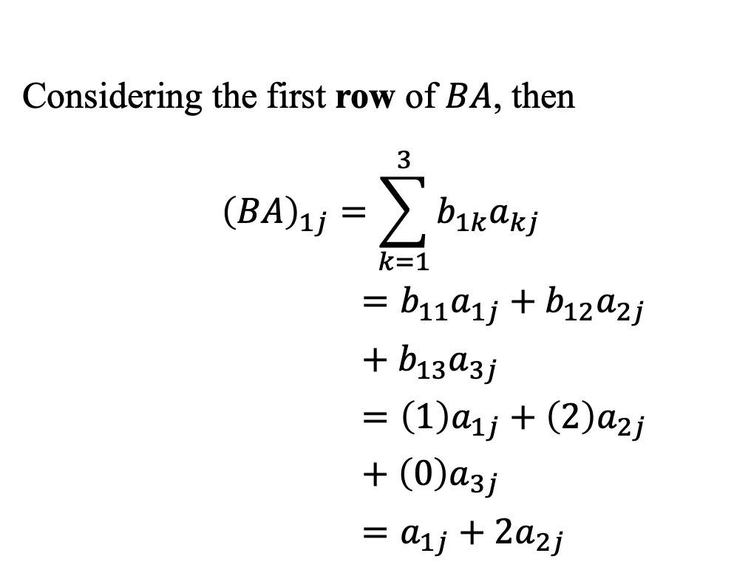


Considering the first row of $BA$, then
$${\left(BA\right)}_{1j}=\sum_{k=1}^{3}{b_{1k}a_{kj}}$$
$$=b_{11}a_{1j}+b_{12}a_{2j}+b_{13}a_{3j}$$
$$=\left(1\right)a_{1j}+\left(2\right)a_{2j}+\left(0\right)a_{3j}$$
$$=a_{1j}+{2a}_{2j}$$
$$≡$$
$$1⋅ + 2⋅$$

